Slide 1
CHAPTER 2
Sources of Information

Slide 2
Research versus Your Experience
Sources of information:
  Intuition
  Personal experiences
  Experts
Notes:
Figure 2.2: Your Own Experience
After hearing about it on TikTok, you may conclude that tapping your face helped calm you in an anxious moment. But does this technique really reduce anxiety?
Our own experiences and the experiences of our friends and family are powerful sources of information.

Slide 3
Research Results Are Probabilistic
Behavioral research is probabilistic, which means that its findings are not expected to explain all the cases all the time (i.e., there are exceptions).
Notes:
Occasionally, you may hear about a research finding on an issue where your personal experience contradicts the results. What do you do in this case? Do you assume that the research is wrong? No. You may acknowledge that your experience might be an exception to what the research shows. Does an exception undermine the results? No.
Psychological research is probabilistic. It’s not expected to explain all cases all the time. However, research conclusions are meant to explain some proportion of the possible cases.

Slide 4
Personal Experience Has No Comparison Group
Compared to what?
Need for a comparison group!
Notes:
One reason why we should not base our beliefs on personal experience alone is that experience has no comparison group. A comparison group allows us to compare what would occur both with and without whatever it is that interests us (e.g., laundry detergent, soy milk, CDs, Levi’s jeans).
Example 1:
Measure anxiety before therapy and after 8 weeks. Anxiety scores go down → “The therapy works!”
With a comparison group:
Group 1: New therapy
Group 2: No treatment (or waitlist)
Both groups show similar reductions.
What the comparison group reveals:
Improvement might be due to time, regression to the mean, placebo effects, or repeated testing—not the therapy itself.
Change over time ≠ causal effect.
Example 2:
Research question: Does caffeine improve memory performance?
Without a comparison group:
Give participants coffee, then test memory. Scores are high → “Caffeine boosts memory.”
With a comparison group:
Group 1: Caffeinated coffee
Group 2: Decaf coffee
Group 3: No coffee
Memory scores are the same.
What the comparison group reveals:
Expectation, arousal, or the testing situation itself may explain performance—not caffeine.
Teaching point:
Comparison groups help isolate the active ingredient of an intervention.

Slide 5
Experience Is Confounded
What are confounds?
What can we do about confounds?
Notes:
In the real world, there are usually several possible explanations for an outcome, and these alternative explanations are called confounds. “Confounded” means confused. You think that one thing caused the outcome but because other things also changed, you’re confused about what the real cause is.
Example: A study in the newspaper discusses the positive effects of tapping on your face on their mood and composure, but it appeared to have a confound. What’s the confound? It appears that because you were also processing anxious thoughts, distracting yourself, and trying to feel better, you can’t determine which of these factors (or combination of factors) caused the improvement.
What can we do about confounds? It’s difficult to isolate variables in our personal experiences, but in a research setting, scientists are able to change one factor at a time.

Slide 6
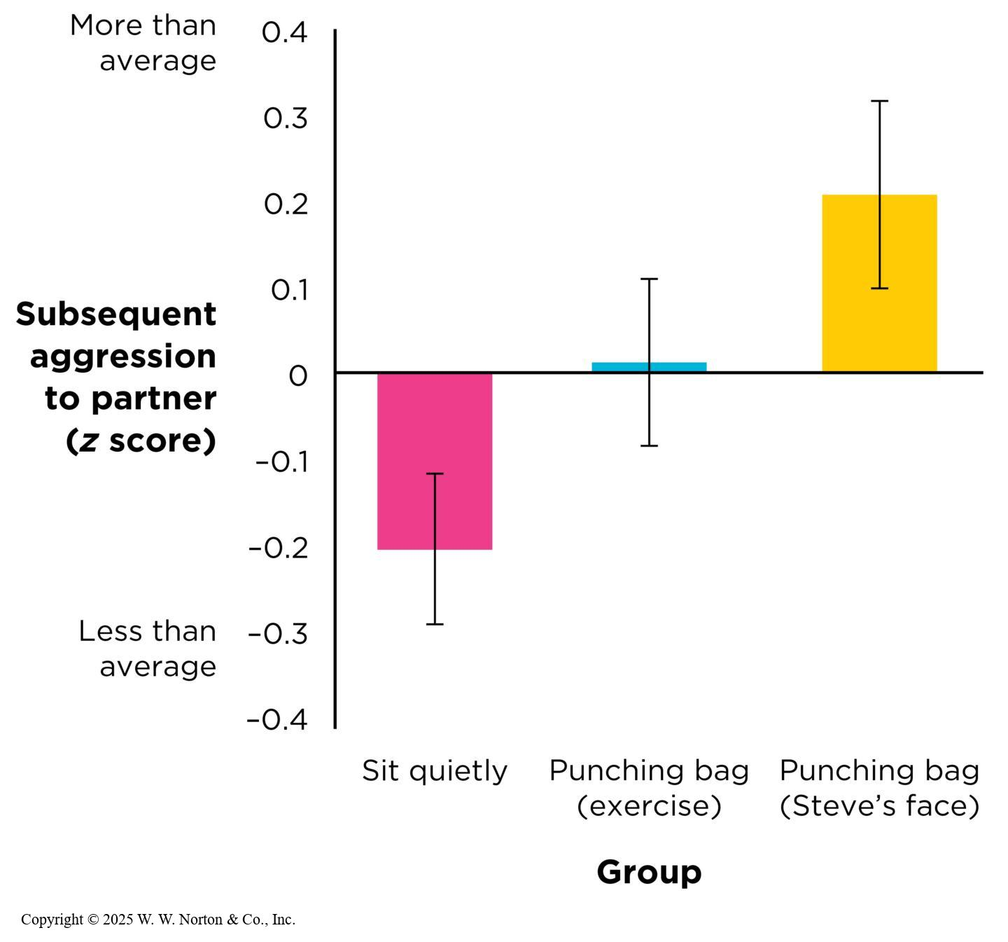
Research Is Better Than Experience
Notes:
Brad Bushman (2002) conducted a study examining the effect on aggression of venting versus not venting anger. The participants were 600 undergraduates. The researcher needed to invoke anger in the participants, so he asked each undergraduate to write a political essay. Participants were instructed to show their essays to Steve, who was a confederate, an actor playing a specific role for the experimenter. He criticized the essays, saying they were the worst he had ever read and making other rude comments.
Undergraduates were randomly assigned to one of three groups: Group 1 was told to sit quietly in the room for 2 minutes, Group 2 was told to punch a punching bag for 2 minutes as a form of exercise, and Group 3 was told to punch a punching bag for 2 minutes while imagining Steve’s face on the bag (catharsis group). Then participants played a quiz game with Steve, and they were given the opportunity to provide a blast of loud noise to Steve’s ears. Which group gave Steve the loudest, longest blasts? Results (Figure 2.4): Group 1 showed less than average levels of aggression, Group 2 showed average levels of aggression, and Group 3 showed greater than average levels of aggression. Note the use of comparison groups and controlling for potential confounds in this study.

Slide 7
The Research versus Your Intuition
The intuitive thinker versus the scientific reasoner
  Intuition: Gut feelings, personal experiences, cognitive biases
  Scientific: Systematic observation, measurement, and evidence
Intuition can be biased
Notes:
By thinking scientifically instead of intuitively, we can eliminate or reduce our cognitive and motivational biases. We do this by reasoning systematically and empirically, as researchers do.
Instead of only examining information that comes to mind easily or the parts that sound good, scientists look at all the data and try to be as objective as possible.

Slide 8
Ways That Intuition Can Be Biased (1 of 4)
Being swayed by a good story
Notes:
Being swayed by a good story: Sometimes we accept a conclusion because it sounds good or it makes sense, even if that good story is false.
Example: To many people, bottling up negative emotions seems unhealthy and expressing anger seems sensible. One of the early proponents of catharsis was the neurologist Sigmund Freud, whose models of mental distress focused on the harmful effects of suppressing one’s feelings and the benefits of expressing them.
Some biographers have speculated that Freud’s ideas were influenced by the industrial technology of his day (Gay, 1989). Back then, engines used the power of steam to create vast amounts of energy. If the steam was too compressed, it could have devastating effects on a machine.
Freud seems to have reasoned that the human psyche functions in the same way. Catharsis makes a good story because it draws on a metaphor (pressure) that is familiar to most people.

Slide 9
Ways That Intuition Can Be Biased (2 of 4)
Being persuaded by what easily comes to mind
  Availability heuristic
Notes:
Figure 2.8: The Availability Heuristic
Americans’ Google search histories suggest that we are overly concerned about certain causes of death—perhaps because they are vivid or because media coverage makes these topics available in our minds. (Source: www.ourworldindata.org)
Being persuaded by what comes easily to mind: The availability heuristic states that things that come to mind easily are more “available” to memory and can guide and/or bias our thinking. This is especially true of memories that are recent or vivid.
Example: Heart disease and cancer kill similar numbers of Americans each year, but cancer is searched for on Google much more often, possibly because it is more reported on in the media and so is more prevalent in the public conscience.

Slide 10
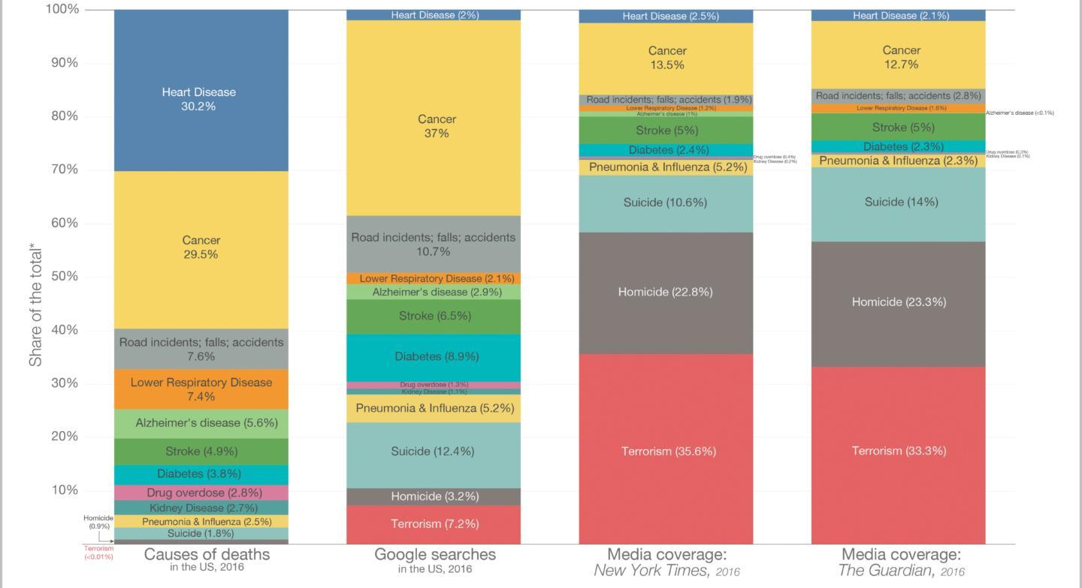
Availability Heuristic
Notes:
Figure 2.8: The Availability Heuristic
Americans’ Google search histories suggest that we are overly concerned about certain causes of death—perhaps because they are vivid or because media coverage makes these topics available in our minds. (Source: www.ourworldindata.org)
Being persuaded by what comes easily to mind: The availability heuristic states that things that come to mind easily are more “available” to memory and can guide and/or bias our thinking. This is especially true of memories that are recent or vivid.
Example: Heart disease and cancer kill similar numbers of Americans each year, but cancer is searched for on Google much more often, possibly because it is more reported on in the media and so is more prevalent in the public conscience.
Our World in Data

Slide 11

Ways That Intuition Can Be Biased (3 of 4)
Focusing the evidence, we expect
  Confirmation bias
Notes:
Figure 2.9 Confirmation bias.
This therapist suspects her client has an anxiety disorder. What kinds of questions should she be asking that would both potentially confirm and potentially disconfirm her hypothesis?
The tendency to look only at information that agrees with what we already believe is called the confirmation bias. We “cherry-pick” the information we take in—seeking and accepting only the evidence that supports what we already think.
Example: One study specifically showed how people select only their preferred evidence to maintain their beliefs. Lebowitz & Ahn (2017) and Ahn et al. (2020) explored this phenomenon in the context of depression and the Beck Depression Inventory (BDI). Participants who were told they had higher BDI scores—indicating a higher likelihood of depressive symptoms—spent more time engaging with materials that downplayed the reliability or relevance of the BDI as a diagnostic tool. Conversely, participants with lower BDI scores focused more on materials supporting the BDI's validity as an accurate measure of depressive symptoms. These behaviors suggest a tendency to selectively analyze information in ways that preserve self-concept. Those with higher scores sought evidence to diminish the test's significance, while those with lower scores embraced its legitimacy to reinforce a more favorable view of themselves. These findings highlight how individuals maintain their beliefs—whether about intelligence, mental health, or other domains—by selectively attending to evidence that aligns with their preferred narrative.
Wavebreak Media ltd/Alamy

Slide 12

Ways That Intuition Can Be Biased (4 of 4)
Being biased about being biased
  Bias blind spot
Notes:
Figure 2.10: The Bias Blind Spot
A physician who receives a free gift from a pharmaceutical salesperson might believe she won’t be biased by it, but she may also believe other physicians will be persuaded by such gifts to prescribe the drug company’s medicines.
Even though we read about the biased ways people think (in places such as a research methods textbook like this one), we nevertheless conclude that those biases do not apply to us. People have a bias blind spot, which is the belief that we are unlikely to fall prey to the other biases previously described.
Example: In one study, researchers interviewed U.S. airport travelers, most of whom said the average American is much more biased than they themselves were (Pronin et al., 2002). For example, the travelers said that while most others would take personal credit for successes, the travelers themselves would not. Respondents believed other Americans would say a person is smart and competent just because he or she is nice; however, they believed that themselves did not have this bias. People also believed that other Americans would tend to “blame the victim” of random violence for being in the wrong place at the wrong time, even though they would do no such thing themselves.
BURGER/PHANIE/Alamy Stock Photo

Slide 13
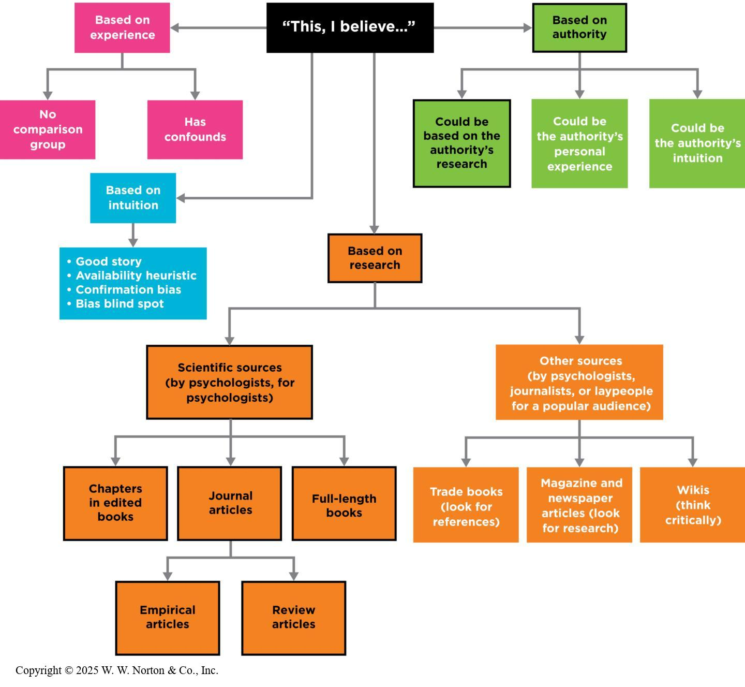
Sources of Information
Notes:
Figure 2.12: A Concept Map Showing Sources of Information
People’s beliefs can come from several sources. You should base your beliefs about psychological phenomena on research rather than experience, intuition, or authority. Research can be found in a variety of sources, some more dependable than others. Ways of knowing that appear in the boxes outlined in black are more trustworthy.
Copyright © 2025 W. W. Norton & Co., Inc.

Slide 14
Finding and Reading the Research
Consulting scientific sources
Finding legitimate scientific sources
Reading the research
Legitimate journalism versus disinformation
Notes:
In order to base your beliefs on empirical evidence, you will need to know how to find and read the scientific research.

Slide 15
Consulting Scientific Sources (1 of 2)
Journal articles: psychology’s most important source
  Empirical journal articles
  Review journal articles
Notes:
Here are the three places where psychological scientists typically publish their research: journal articles, chapters in edited books, and full-length books.
Journal articles: These are psychology’s most important source. Journals are periodicals, which are published periodically the way magazines are (journals are usually published monthly or quarterly, like magazines). However, scientific journals look different from popular magazines (e.g., they aren’t colorful and glossy and don’t include advertisements but rather are written for an audience of other psychological scientists and students of psychology). Journal articles are peer-reviewed. You can find journals in college and university libraries or by using online academic databases.
There are two major types of journal articles: empirical and review.
Empirical journal articles: report the method and results for research studies that are being reported for the first time.
Review journal articles: summarize all the published studies that have been conducted in that particular research area. Review articles can be narrative reviews of the literature that qualitatively summarize the research, or they may use a quantitative approach called a meta-analysis to combine the results of many studies statistically.

Slide 16

Consulting Scientific Sources Sources (2 of 2)
Chapters in edited books
Full-length books
Notes:
Figure 2.14: The Variety of Scientific Sources
You can read about research in empirical journal articles, review journal articles, edited books, and full-length books.
Chapters in edited books: An edited book is comprised of chapters on a common topic or theme, and each chapter is written by a different author. The editor invites authors to contribute to the book, and each chapter usually summarizes a body of research and theory. Chapters aren’t peer-reviewed with the rigor that journal articles are, but the editor carefully selects the contributors and will be confident about their expertise. The audience is other psychologists and students of psychology.
Full-length books: This is not a common way for psychologists to publish their work, but it is common in other disciplines. A full-length book contains a description of research written by one person (or several if they collaborate). Full-length books written for psychologists can be found in university libraries. However, most full-length books aren’t written for other psychologists but rather for a general audience.
Courtesy of Author

Slide 17
Finding Legitimate Scientific Sources
PsycINFO
Google Scholar
Quality Matters
Paywalled versus open access sources
Notes:
Table 2.1: Tips for Turning Your Question into a Successful Database Search
PsycINFO: PsychINFO is a database and search engine for finding research articles in psychology. It is maintained by the American Psychological Association (APA). It’s similar to Google, but it only searches for sources in psychology and related fields. Most articles on PsycINFO are peer-reviewed. You need to have access to a college or university library to use it. You can search by author, title, journal, and so on. My university library has an online tutorial for using PsycINFO, and your school might, too.
Google Scholar: If you want to find empirical research but don’t have access to PsycINFO, you can try the free tool Google Scholar. It works like the regular Google search engine, except the search results are only in the form of empirical journal articles and scholarly books.
Not all journals are reliable—some are predatory and will publish anything that is submitted.
Some articles are paywalled—they require a subscription to access—while others are open access—available for free. While you are in college, you have access to almost any article.
Copyright © 2025 W. W. Norton & Co., Inc.

Slide 18
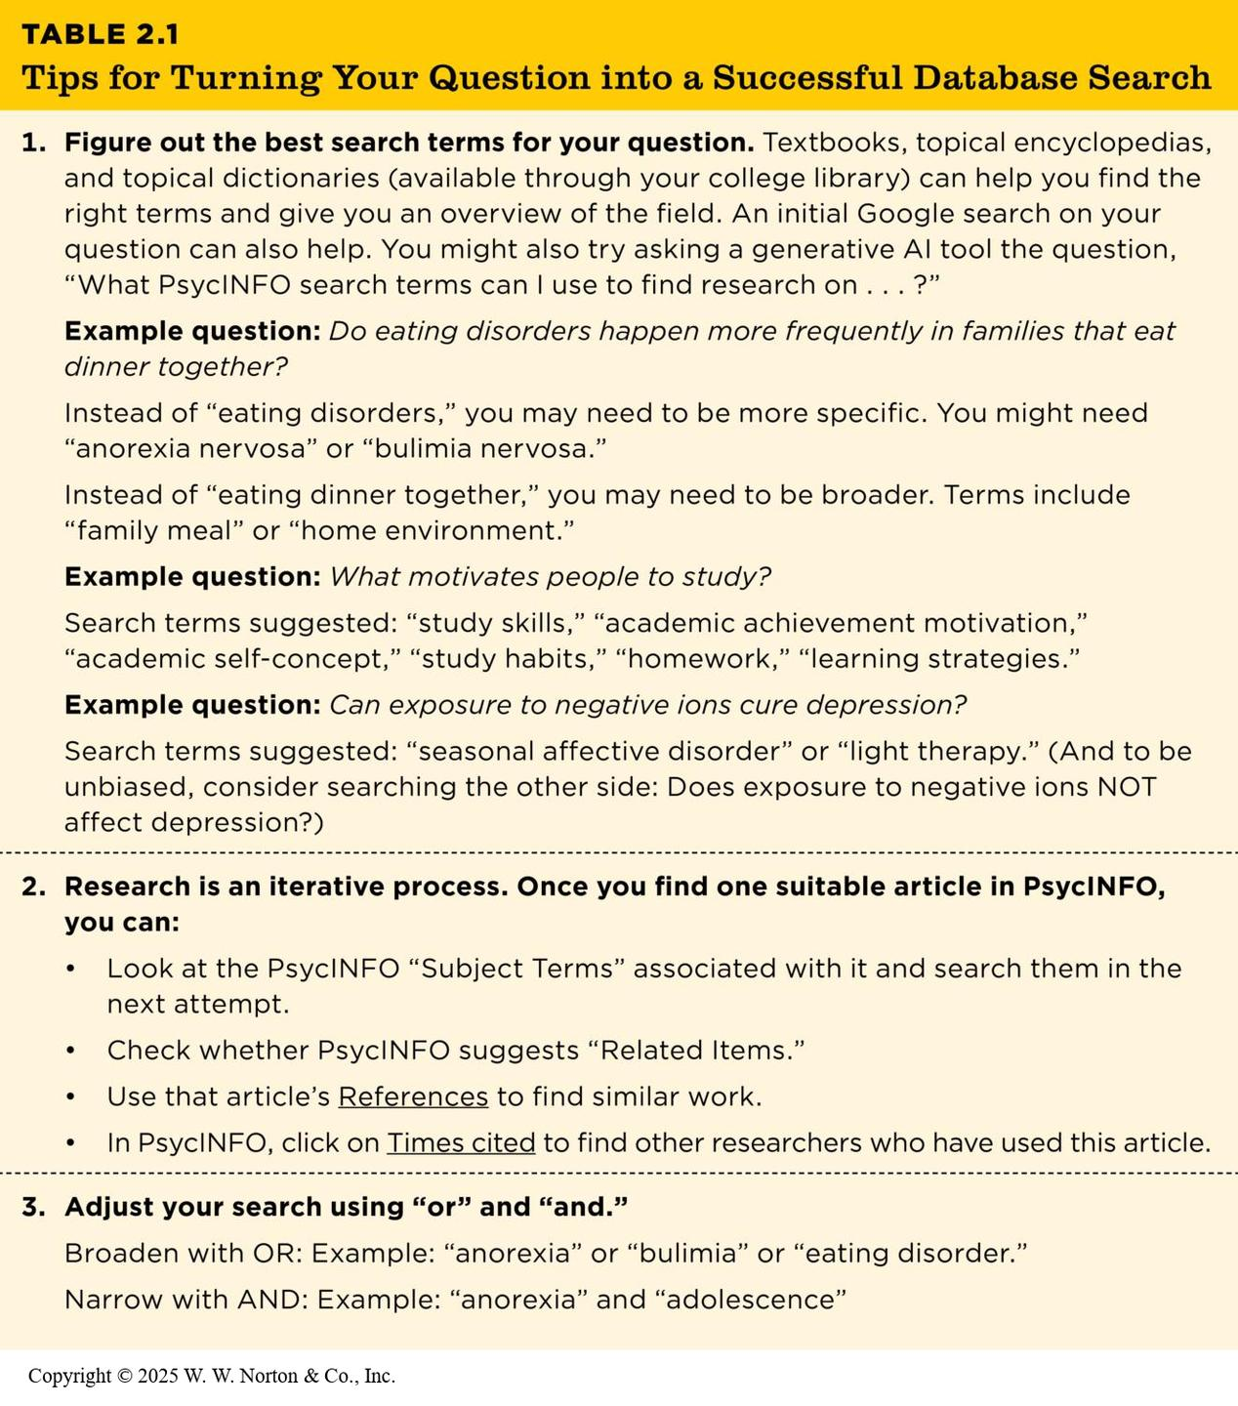
Finding Legitimate Scientific Sources (2)
Notes:
Table 2.1: Tips for Turning Your Question into a Successful Database Search
PsycINFO: PsychINFO is a database and search engine for finding research articles in psychology. It is maintained by the American Psychological Association (APA). It’s similar to Google, but it only searches for sources in psychology and related fields. Most articles on PsycINFO are peer-reviewed. You need to have access to a college or university library to use it. You can search by author, title, journal, and so on. My university library has an online tutorial for using PsycINFO, and your school might, too.
Google Scholar: If you want to find empirical research but don’t have access to PsycINFO, you can try the free tool Google Scholar. It works like the regular Google search engine, except the search results are only in the form of empirical journal articles and scholarly books.
Not all journals are reliable—some are predatory and will publish anything that is submitted.
Some articles are paywalled—they require a subscription to access—while others are open access—available for free. While you are in college, you have access to almost any article.
Copyright © 2025 W. W. Norton & Co., Inc.

Slide 19
Reading the Research
Components of an empirical journal article
  Abstract
  Introduction
  Method
  Results
  Discussion
  References
Notes:
This is a roadmap for what you will find in an empirical journal article:
Abstract: summary of the article; read it to figure out what the article is about.
Introduction: explains the topic of the study, describes the theoretical and empirical background for the research, and states the specific research goals for the current study
Method: how the researchers conducted the study; includes subsections on participants, materials, procedure, and apparatus.
Results: describes the statistical tests used and the quantitative or qualitative results of the study.
Discussion: summarizes the study and discusses the study’s significant contributions and perhaps alternative explanations for their results.
References: full bibliographic listing of all the sources the authors cited in the article.

Slide 20
Reading with a Purpose
Empirical journal articles
  What is the argument?
  What is the evidence to support the argument?
Chapters and review articles
  What is the argument?
  What is the evidence?
Notes:
Now that you’ve found your article or book, you need to know how to read it with a purpose.
Empirical journal articles: You don’t need to read every word of the article. What is the argument? First read the abstract, then skip to the end of the introduction to read about the goals of the current study, then read the rest of the introduction. You might also read the first paragraph of the Discussion section. What is the evidence? Read the Method and Results sections.
Chapters and review articles: These don’t have sections like journal articles, but you should still ask the same two questions. What is the argument? (This will be the purpose of a chapter or review article; it might be an entire theory.) What is the evidence? (The evidence is the research that the author reviews.)

Slide 21
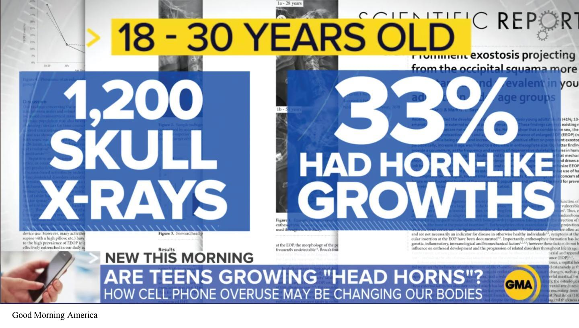
Legitimate Journalism Versus Disinformation
Science in the popular media
Avoiding disinformation
Notes:
Figure 2.16: Journalists May Not Cover the Best Research
This sensational news report was based on a single research study that was later widely criticized by other researchers and journalists. Although the news report prominently displays some of the numerical values from the study, the study’s method was not adequate to determine that cell phone use was “changing our bodies.”
The popular press: magazines, newspapers, TV news, radio news shows, web-based magazines and blogs; designed for a popular audience, so they don’t always accurately reflect the scholarly research.
Disinformation: the deliberate creation and sharing of information known to be false. People spread disinformation for several reasons and of several different types. Some is completely false, while some is more subtle.
Good Morning America (2019)

Slide 22
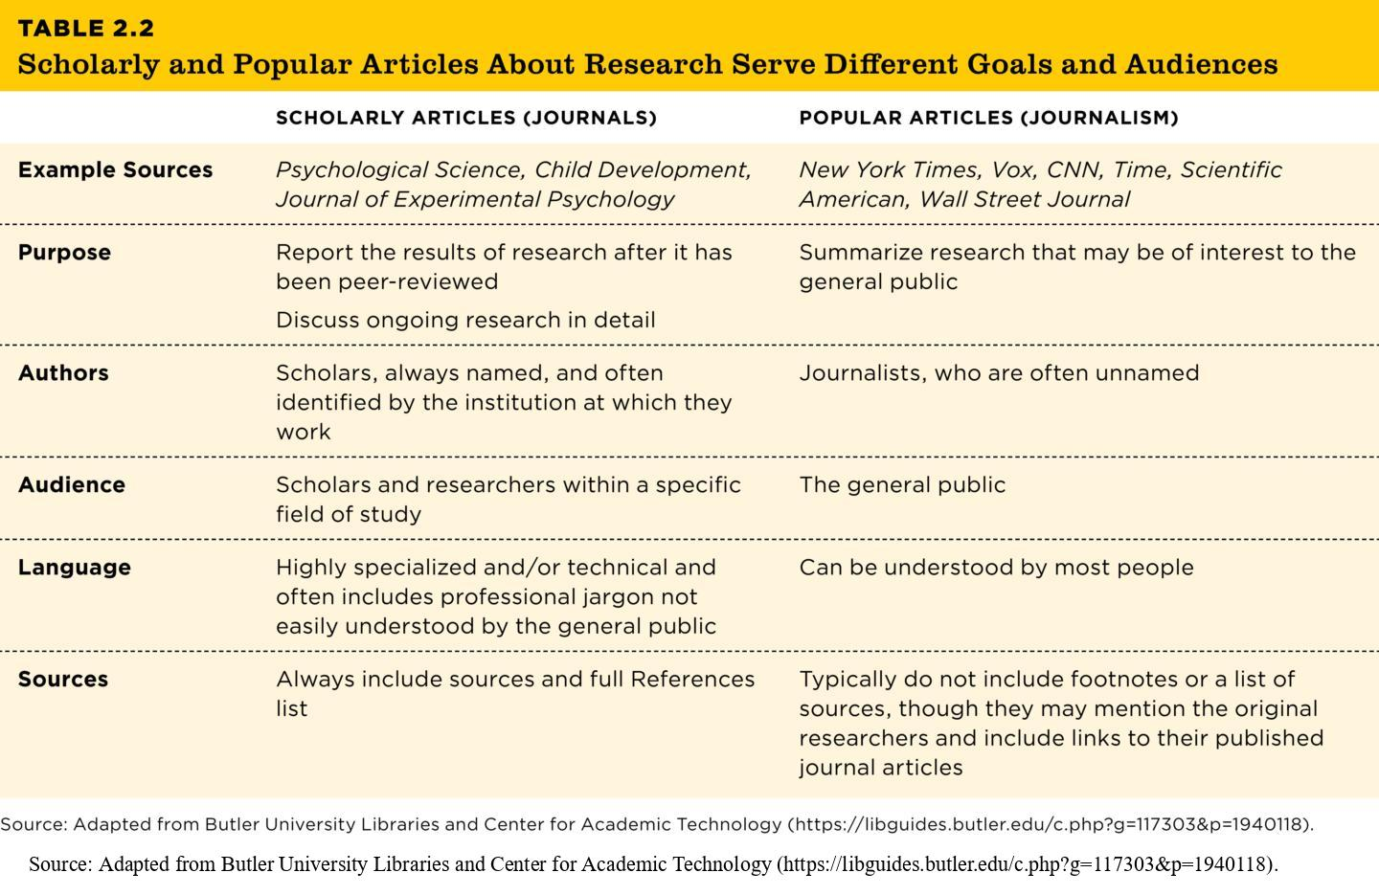
Goals and Audiences of Scholarly and Popular Articles
Table 2.2
TABLE 2.2 Scholarly and Popular Articles About Research Serve Different Goals and Audiences
 | SCHOLARLY ARTICLES (JOURNALS) | POPULAR ARTICLES (JOURNALISM)
Example Sources | Psychological Science, Child Development, Journal of Experimental Psychology | New York Times, Vox, CNN, Time, Scientific American, Wall Street Journal
Purpose | Report the results of research after it has been peer-reviewed
Discuss ongoing research in detail | Summarize research that may be of interest to the general public
Authors | Scholars, always named, and often identified by the institution at which they work | Journalists, who are often unnamed
Audience | Scholars and researchers within a specific field of study | The general public
Language | Highly specialized and/or technical and often includes professional jargon not easily understood by the general public | Can be understood by most people
Sources | Always include sources and full References list | Typically do not include footnotes or a list of sources, though they may mention the original researchers and include links to their published journal articles
Source: Adapted from Butler University Libraries and Center for Academic Technology (https://libguides.butler.edu/c.php?g=117303&p=1940118).
Notes:
Table 2.2: Scholarly and Popular Articles About Research Serve Different Goals and Audiences
Source: Adapted from Butler University Libraries and Center for Academic Technology (https://libguides.butler.edu/c.php?g=117303&p=1940118).

Slide 23

Avoiding Disinformation
Motives for disinformation
  Propaganda, passion, and politics
  Provocation
  Profit
Types of disinformation
Notes:
Figure 2.17: Disinformation can have dire consequences.
Disinformation-based conspiracy theories motivated several actors in the insurrection of January 6, 2021, which killed five people and threatened U.S. democracy’s peaceful transfer of power.
Disinformation is “the deliberate creation and sharing of information known to be false” (Wardle, 2017).
Disinformation-based conspiracy theories motivated several actors in the insurrection of January 6, 2021, which killed five people and threatened U.S. democracy’s peaceful transfer of power.
SAUL LOEB/AFP via Getty Images

